Slide 1
COMPETITIVE PRICING INTELLIGENCE
Competitive Pricing Intelligence Dashboard
Business Intelligence Dashboard for Swiggy, Zomato & Toing
Pricing • Discounts • Hidden Charges • Delivery Performance Analysis
SWIGGY
ZOMATO
TOING
Prepared by
Bhupendra Kumar
Data Analyst

Slide 2
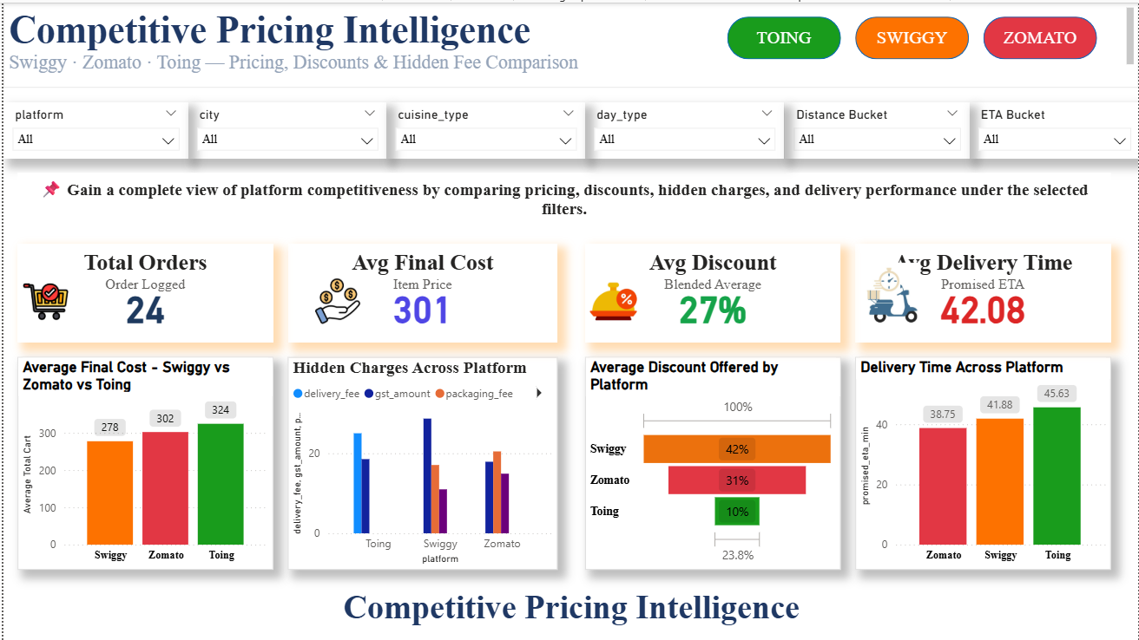
05
Platform Summary
Consolidated insights & key takeaways across all platforms
DASHBOARD
Insert Dashboard Screenshot Here
Page 5 of 5

Slide 3
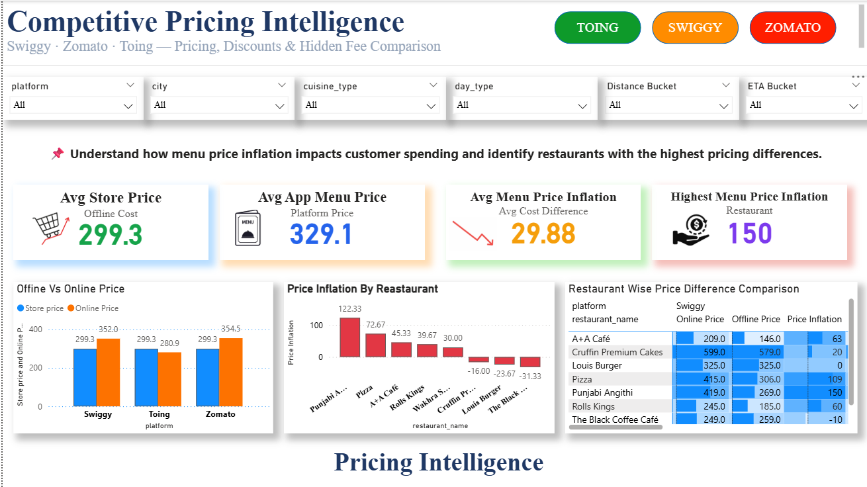
01
Pricing Overview
Base menu pricing comparison across Swiggy, Zomato & Toing
DASHBOARD
Insert Dashboard Screenshot Here
Page 1 of 5

Slide 4
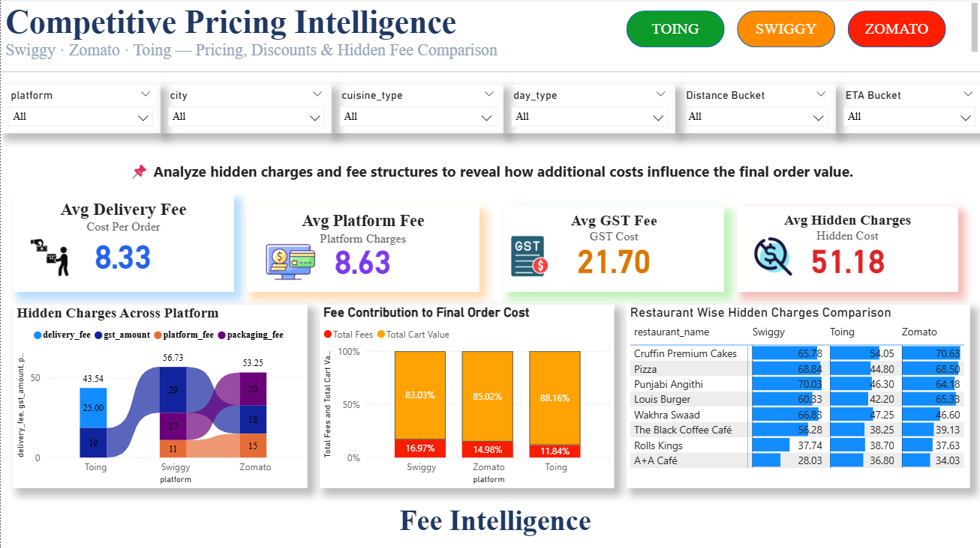
02
Discount Analysis
Coupon, offer & effective-discount comparison across platforms
DASHBOARD
Insert Dashboard Screenshot Here
Page 2 of 5

Slide 5
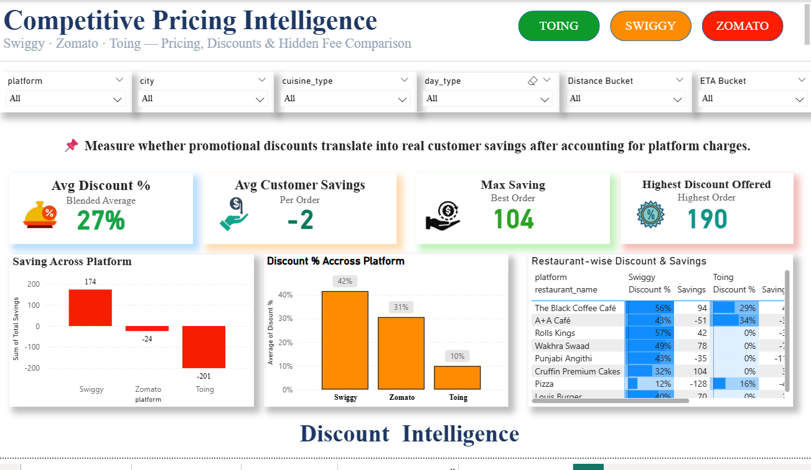
03
Hidden Charges Breakdown
Platform fees, packaging, surge & other add-on charges
DASHBOARD
Insert Dashboard Screenshot Here
Page 3 of 5

Slide 6
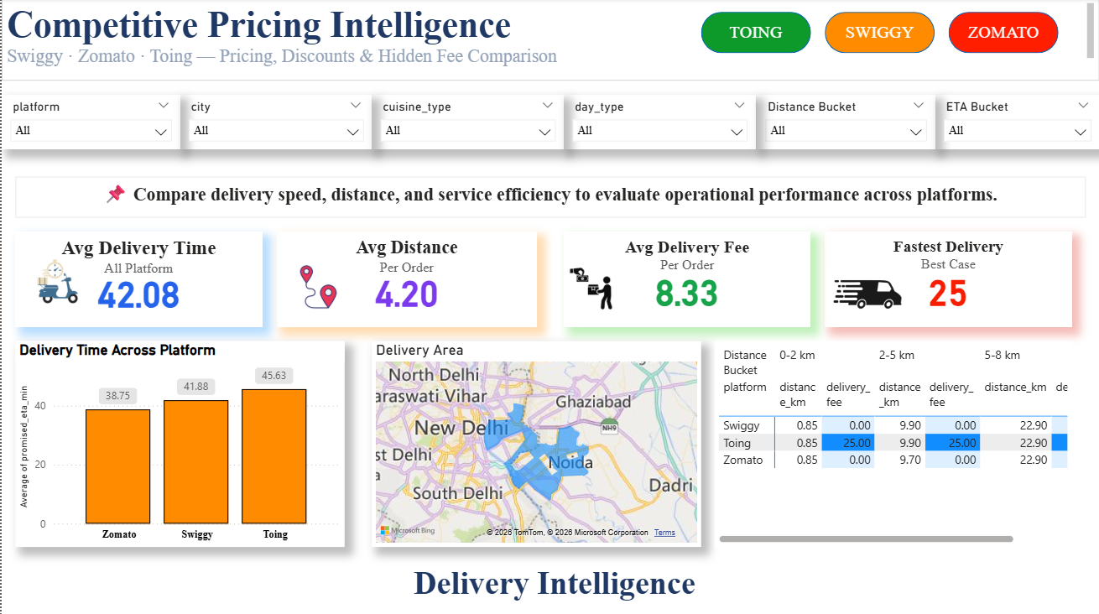
04
Delivery Performance Analysis
Delivery time, distance & SLA performance benchmarking
DASHBOARD
Insert Dashboard Screenshot Here
Page 4 of 5

Slide 7
THANK YOU
Competitive Pricing Intelligence Dashboard
Swiggy • Zomato • Toing
SWIGGY
ZOMATO
TOING
Bhupendra Kumar
Data Analyst

